Slide 1

Introduction to App Inventor
David Wolber
University of San Francisco

Slide 2
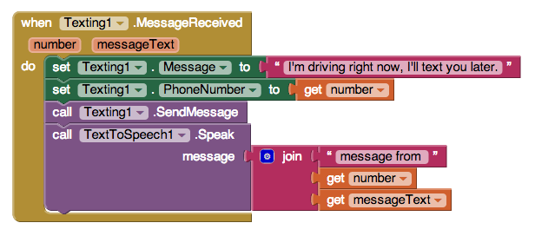
This is an App Inventor app. Can you tell what it does?
Notes:
Ask students to discuss this with those next to them. The app auto-responds to texts and speaks them aloud. Mention what a textbox is and the fact that the auto-response can be customized by user.

Slide 3
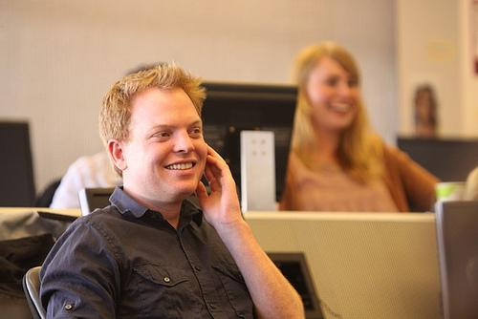

No Texting While Driving
USF Student Daniel Finnegan created the app in a beginning course.
He was an English Major
"Software, after all, affects almost everything we do. Pick any major problem—global warming, health care, or, in Finnegan’s case, highway safety—and clever software is part of the solution. Yet only a tiny chunk of people ever consider learning to write code, which means we’re not tapping the creativity of a big chunk of society."
Clive Thompson, Wired
Notes:
I love Thompson's quote and usually read it aloud.

Slide 4
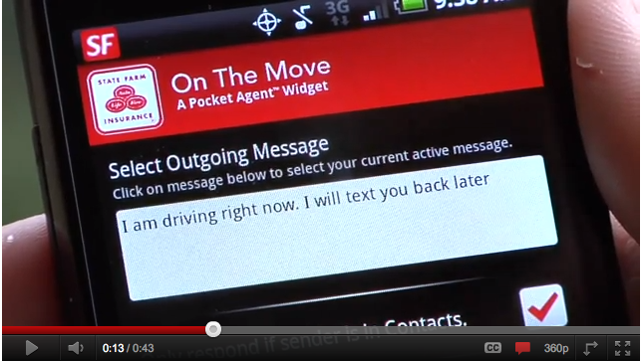
State Farm liked it...
Notes:
State farm app came out a few months later... might not have been based on No Text While Driving but the fact that we wondered about it--a beginning non-major's first creative app having an impact-- is incredible.

Slide 5
Could you make the app send a particular response to a particular number (e.g., your significant other)?
How about an app to vote by text?
Notes:
Mention "if" and how it can be used to add artificial intelligence (logic) to any degree of complexity.
Make connection to voting on tv shows like dancing with the stars.

Slide 6
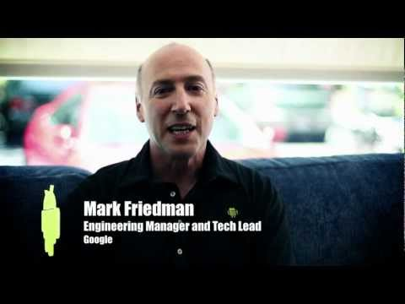
USF students, Professor Wolber, and Google Engineer Mark Friedman on App Inventor at USF:

Slide 7
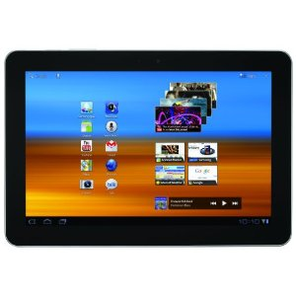
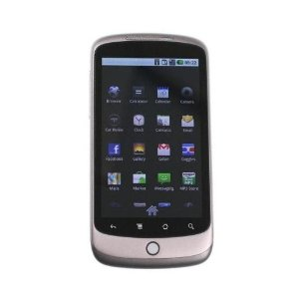
What can you build with App Inventor?
Games
Android, Where's my car?
Text Processing Apps
Quizzes
Web Enabled Apps
Location Aware Apps
Broadcast Hubs

Slide 8
Instructor Demo: Raffle App
Show App Inventor's 3 windows: Designer,Blocks,Emulator
Use a Texting.MessageReceived and a list
add sender's phone numbers to a list
On button click, choose randomly and call winner.
Notes:
Note that this is not something a beginner could do on their own, but an example of something the students will be able to do soon

Slide 9
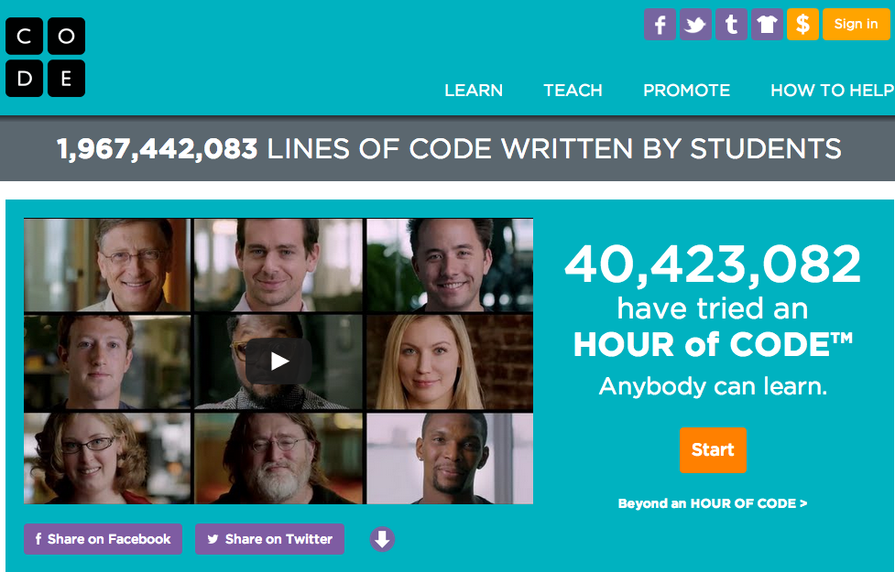
Coding as a 4th R?

Slide 10
Why Learn App Inventor?
Software is in every walk of life. Programming is becoming part of many jobs
Explore mobile computing
Practical Skills -- web, math, media
Prep for learning Java, Python, Javascript, etc.
Creativity, entrepreneurship, idea formulation
Problem-Solving skills

